Slide 1
It’s a Small World
Dr David J. Haw

Slide 2
Session aims
In 3 hours time, you will be able to:
Use simple rules to define large networks
Define and compute the local clustering coefficient
Compare and contrast different centrality measures
Construct small networks that demonstrate

Slide 3
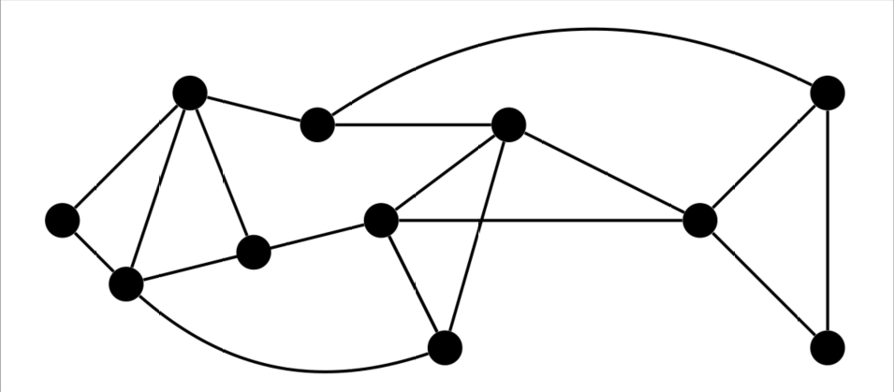
Networks: basic properties
Networks consist of a set of nodes N and a set of edges E
Simple: undirected, unweighted, no self loops

Slide 4
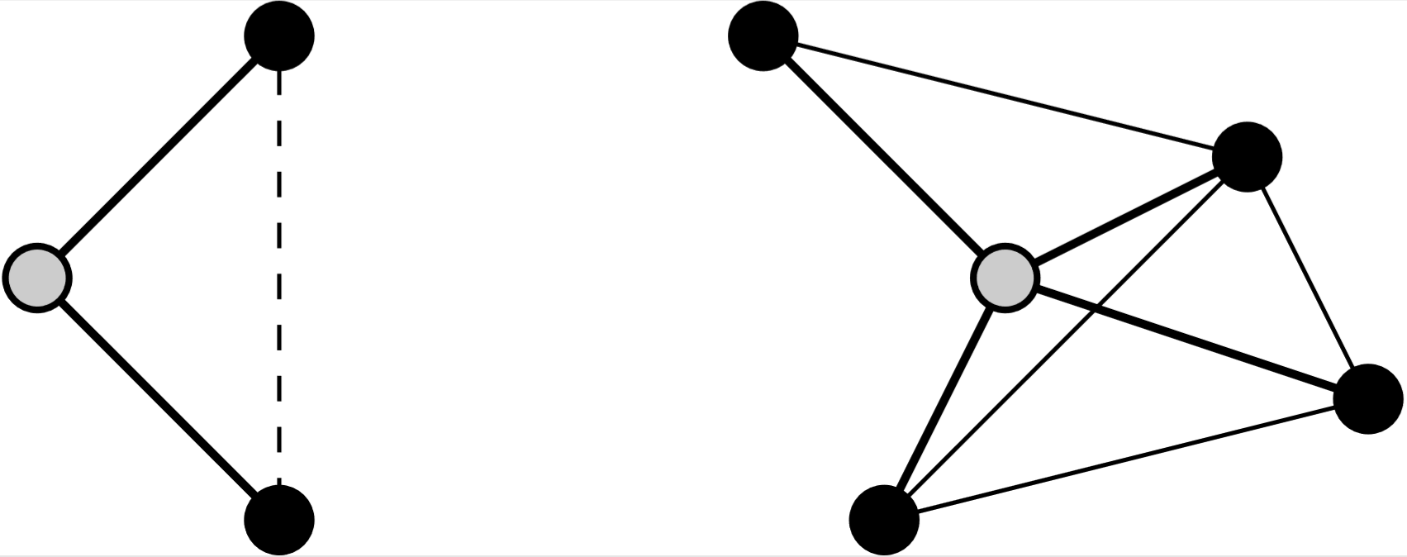
Metrics
Characteristic path length L: average shortest path length between 2 nodes
Clustering coefficient: density of edges between neighbours
QUESTION: What is the clustering coefficient of the grey node (right)?

Slide 5
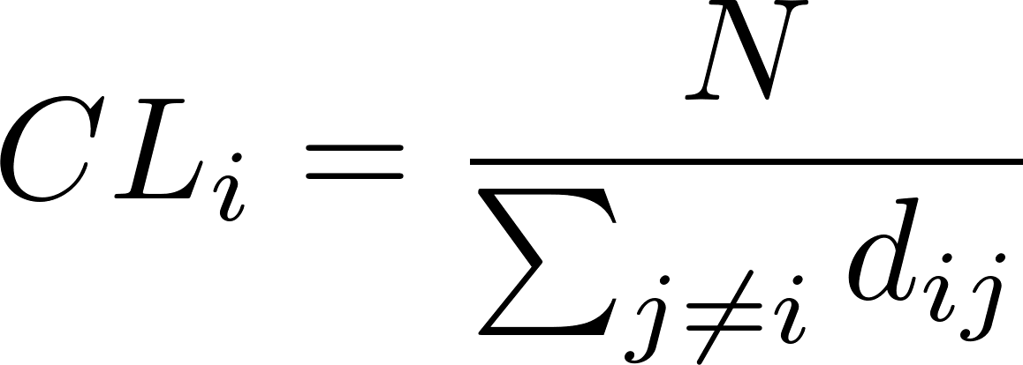
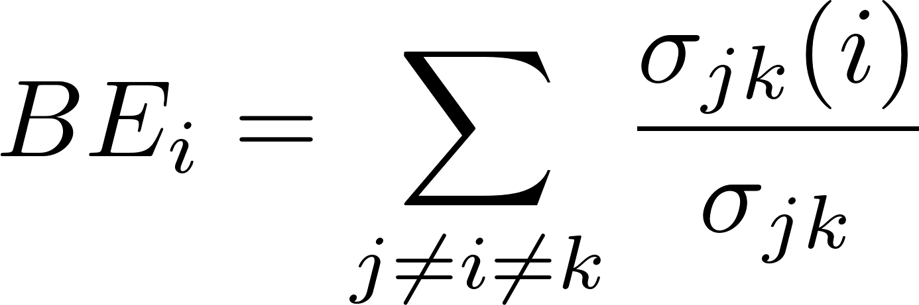
Centrality
Degree
Eigenvector (dominant eigenvector of A):
  “the centrality of i is the mean of the centrality of its neighbours”
Closeness:
“inverse of the sum of all shortest paths to other nodes, accounting for network size”
Betweenness:
“proportion of all shortest paths between nodes that pass through i”

Slide 6
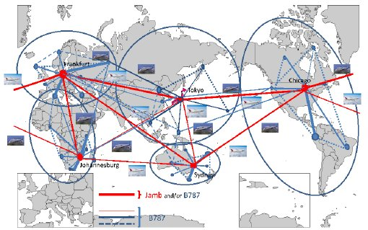
Centrality: discussion
Here is an airline network (passengers/day, undirected).
What would different centrality measures tell you?
There is long list of centrality measures and their variants.
What conclusions can you draw from this observation?
What will these measures tell you about disease transmission?

Slide 7
Centrality: discussion
Draw a simple network with a node that has (relatively):
High degree, high closeness
High degree, low closeness
High degree, high betweenness
Low degree, high betweenness
Low closeness, high betweenness

Slide 8
Random graphs: discussion
N nodes, any pair connected with probability p
What are the following:
1. Mean degree <k>
2. Degree distribution P(K=k)
3. Expected clustering coefficient <CC_i>
4. Characteristic path length L
5. Expected closeness centrality < CL_i>
Are random networks a good model for human contact patterns?
Is there a good compartmental approximation?

Slide 9
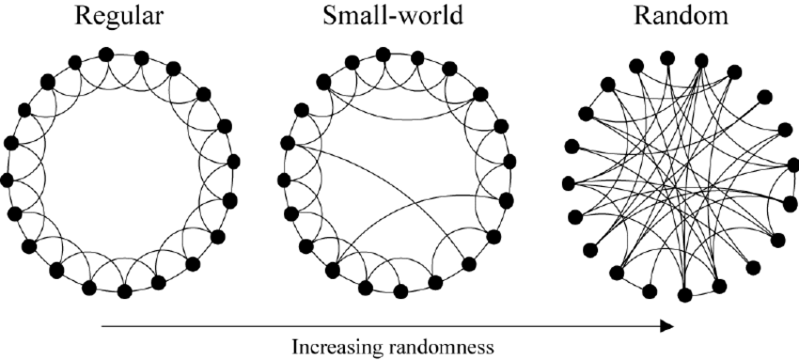
Modelling Social Contacts
QUESTION: how well do these networks model social contacts?
HINT: think characteristic path length/ clustering

Slide 10
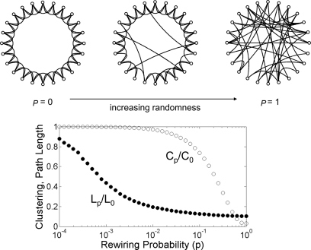
Small Worlds
Small CPL
(“6 degrees of separation”)
What’s your
Erdos-Bacon number?
High clustering
Mean degree preserved
Best of both worlds?

Slide 11
Further reading
Watts & Strogatz 1998
Collective dynamics of ‘small-world’ networks
Barabasi & Albert 1999
Emergence of Scaling in Random Networks
Newman 2002
The spread of epidemic disease on networks
Albert & Barabasi
Statistical mechanics of complex networks

